Slide 1
STW104KM
Software Development Process

Slide 2
OVERVIEW
Why software methodologies are necessary?
Diversity
Comparators
Selection?

Slide 3
WHY ARE METHODOLOGIES USED?
Adopted approach
Framework
  E.g. SSADM, DSDM, RUP……
Better quality systems
Ensures user requirements are met completely
Aids in project management
Notes:
Provides an agreed structure for the development process
Normally an org will adopt a specific approach to develop a software system, which may be referred to a Project Lifecycle, methodology or project plan.
Usually the same framework will be used for all projects developed within an organisation and provides the basis for a standard approach to developing software. For example…..

Slide 4

WHY?
Reduce iterating number of times with different requirements
Promotes communication
Catches Problems when they occur
Standardisation of process and documentation
Reduce REWORK
Reduces RISK
Notes:
(Project management)– better control, execution and reduction in overall development
(Communication) - amongst project participants by defining essential participants and interaction.
(Standardisation) – Helps to encourage the transmission of know how throughout an organisation.

Slide 5
THE NEED FOR DIFFERENT APPROACHES…
Different methodologies place emphasis on different aspects of the system development process.
E.g. SSADM
Notes:
Approaches are constantly changing to accommodate new technologies.
SSADM4 was changed to make the methodology more compatible with OO development approach.

Slide 6
CHOOSING A METHODOLOGY
Issues to consider
  Who are the stakeholders?
  What type of system is being developed?
  What are the principal features of the environment in which the system(s) is to be developed? ( Most difficult to address)
  Long term/ Short term
Notes:
Environment – Cultural and social aspects, tools to support development, constraints eg. Money and time and the nature of the existing system.

Slide 7
Waterfall
Feasibility
Traditional ‘Software Development Life Cycle’ (SDLC)
Structured / measurable approach
Based upon traditional approach to product design
Sequential flow
Most commonly used
Requirements
Analysis
Design
Construction
Testing
Installation
Maintenance

Slide 8
Waterfall – Pros & Cons
Sequential approach adds discipline
Assists project management
Each stage must be completed before moving on to the next
Few projects (if any) follow a sequential pattern
Assumes ‘right-first-time’ at every stage
Long lead time before any software delivered
Bottlenecks delay progress
Slow to embrace changes

Slide 9
Waterfall with Iteration
Feasibility
Same structure as Waterfall approach plus:
  Iteration within stages until criteria satisfied
  More able to manage non-sequential projects
  Able to consider bottlenecks and changes in advance
Requirements
Analysis
Design
Construction
Testing
Installation
Maintenance

Slide 10
SOFTWARE PROTOTYPING
Mock-up of aspect of system
Vary in functionality and utility
Some designed to be thrown away
Help users evaluate requirements
  show actual data in context
  Provide opportunity for users to test interfaces
  Communication device between users and developers
Only a mock-up
  May imply application is more complete than it actually is

Slide 11
Software Prototyping – life cycle
Initial
analysis
Define
Objectives
Specify
Prototyping
Completed
Evaluate
Construct
Notes:
In Iterative model, iterative process starts with a simple implementation of a small set of the software requirements and iteratively enhances the evolving versions until the complete system is implemented and ready to be deployed.
The spiral model combines the idea of iterative development with the systematic, controlled aspects of the waterfall model.

Slide 12
Software Prototyping – Pros & Cons
Improved understanding between Client/Developer/User
  Catch ‘missed’ requirements
  Easier to change existing requirements / add new requirements
Potential problems identified at an early stage
  Functionality
  Usability
  Interface
Progressively build up confidence in what the system can /can’t do
Client/User may not understand that iterations are only prototypes
  Expect ‘early’ delivery
  Expect reduced cost
  Add extra requirements
May divert attention from functional to interface issues
Prototypes require significant
Client/User involvement
Co-ordination of activities requires careful
planning and management

Slide 13
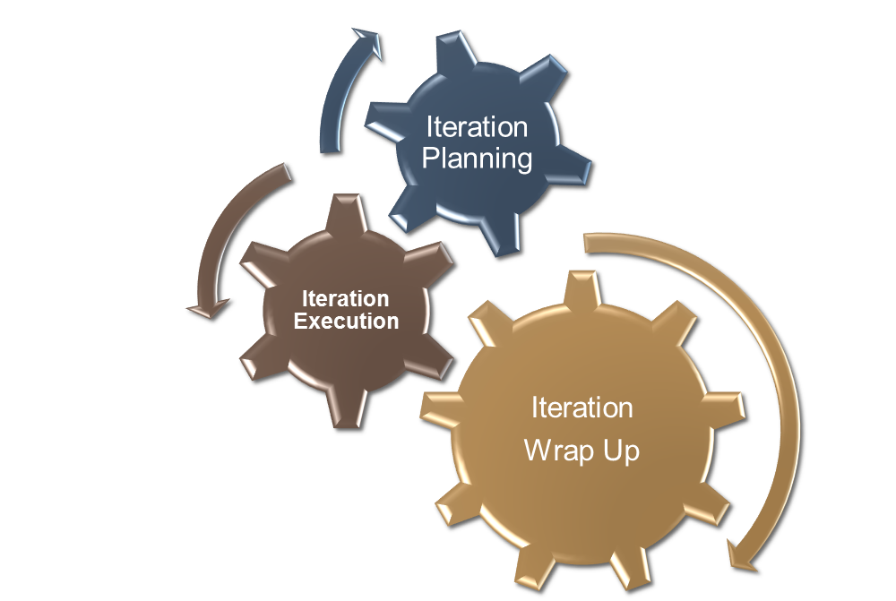
AGILE MODEL
Pre-Planning
Pre-Planning
Release
Notes:
Agile model is a combination of iterative and incremental process models with focus on process adaptability and customer satisfaction by rapid delivery of working software product.

Slide 14
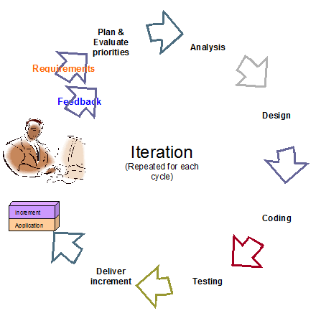
AGILE MODEL FLOW
Notes:
The known requirements are understood and prioritized. The development is planed, and drawn accordingly.
Relative complexity of each requirement is estimated
Sufficient design using simple diagrams is done
Test Driven Development(TDD) approach may be used. TDD emphases on “writing test first and then writing code to pass the test”. It can help in avoiding over-coding.
Development is done, sometimes in pairs, with lot of team interaction. Ownership of code is shared when pair programming is done.
The code is tested more frequently. Sometime a dedicated “Continuous Integration” Server/Software may be used to ease the integration testing of the code.
Depending on the feedback received, the code is refractor. Refactoring does not impact the external behaviour of the application but the internal structure may be changed to provide better design, maintainability. Some ways of refactoring may be add interface, use super class, move the class etc.

Slide 15
AGILE MODEL
Pros | Cons
Less Defects in the final product | Lack of documentation
Adaptable to changing requirements | Hard to have good system design
Iterations provide an immediate feedback

Slide 16
AGILE METHODOLOGIES
eXtreme programming
SCRUM
Agile Modeling
Adaptive Software Development
Crystal Clear and other Crystal methodologies
Dynamic Systems Development Methods
Feature Driven Development
Lean software development
Notes:
Extreme Programming: Concentrates on the development rather than managerial aspects of a software development process
Scrum: Unlike XP considers both managerial and development aspects of software development process

Slide 17
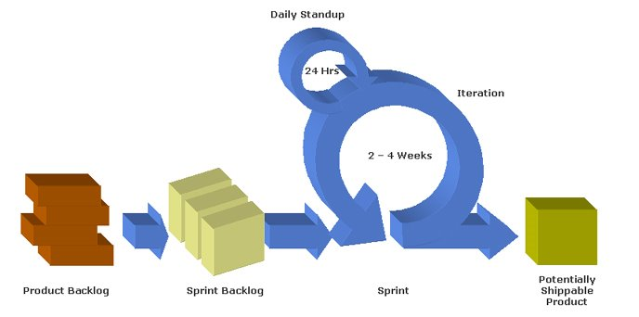
SCRUM METHODOLOGY

Slide 18
DSDM
The Dynamic System Development Method is a Rapid Application Development method that uses incremental prototyping.
As the name suggests, develops the system dynamically.
The time is fixed, resources are fixed while the requirements are allowed to change
It assumes that all previous steps may be revisited as part of its iterative approach.
Therefore, the current step need be completed only enough to move to the next step, since it can be finished in a later iteration
http://www.youtube.com/watch?v=Jdv90Vbp-wo
Notes:
In a nutshell, the Dynamic System Development Method (DSDM) is a game-changing, non-proprietary agile application development project model for developing business solutions within tight timeframes. It shortens the clock-speed (and time to market) for delivery of core business benefits. DSDM is the only approach that can guarantee delivery on an exact day under tight, Internet-time deadlines. It's tool-independent – there are no tools or software packages to buy (or be hamstrung by).

Slide 19
DYNAMIC SYSTEMS DEVELOPMENT METHOD - DSDM
Functionality
Time Resources
Variable
Fixed
Time Resources
Functionality

Slide 20
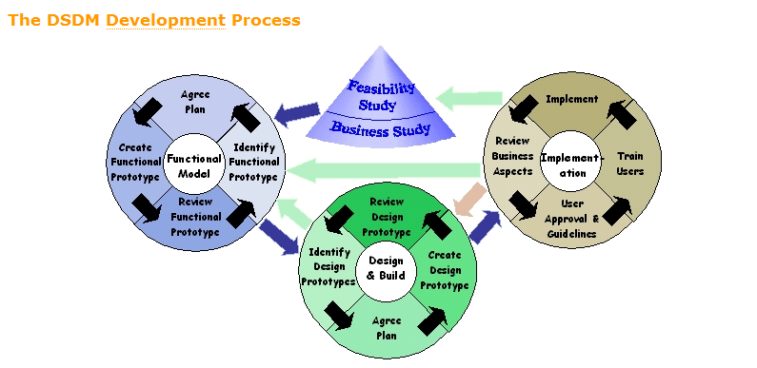

Slide 21
MOSCOW RULES
Requirements are prioritised using MOSCOW rules.
Must have - fundamental to the projects success
O
Should have - important but the projects success does not rely on these
Could have – can easily be left out without impacting on the project
O
Won’t have – this time round, can be left out and done at a later date.

Slide 22
DSDM (FUNCTIONAL MODEL ITERATION)
The main focus in this phase is on building the prototype iteratively and getting it reviewed from the users to bring out the requirements of the desired system.
The prototype is improved through demonstration to the user, taking the feedback and incorporating the changes.
This cycle is repeated generally twice or thrice until a part of functional model is agreed upon.
The end product of this phase is a functional model consisting of analysis model and some software components containing the major functionality.

Slide 23
DSDM (DESIGN AND BUILD ITERATION)
This phase stresses upon ensuring that the prototypes are satisfactorily and properly engineered to suit their operational environment
The software components designed during the functional modelling are further refined till they achieve a satisfactory standard.
The product of this phase is a tested system ready for implementation.
There is no clear line between these two phases and there may be cases where while some component has flown from the functional modelling to the design and build modelling while the other component has not yet been started.
The two phases, as a result, may simultaneously continue.

Slide 24
DSDM (IMPLEMENTATION)
In this phase the users are trained and the system is actually put into the operational environment.
At the end of this phase, there are four possibilities, as depicted by figure:
  Everything was delivered as per the user demand, so no further development required.
  A new functional area was discovered, so return to business study phase and repeat the whole process.
  A less essential part of the project was missed out due to time constraint and so development returns to the functional model iteration.
  Some non-functional requirement was not satisfied, so development returns to the design and build iterations phase.

Slide 25
RUP
The Rational Unified Process (RUP) is an iterative software development process framework created by the Rational Software Corporation, a division of IBM
Goal is to produce a high quality software within the predicted schedule
All the team members irrespective of their work share the view of how the software is developed

Slide 26
RUP (CONTINUED…)
Development cycle is divided into four consecutive phases.
  Inception phase (High level plan, 3 weeks)
  Elaboration phase (Detailed scope & Prototype, 6 weeks)
  Construction phase (Implementation, 14 weeks)
  Transition phase (UAT & release, 3 weeks)
Each phase is concluded with a well-defined milestone. Each phase has a specific purpose.

Slide 27
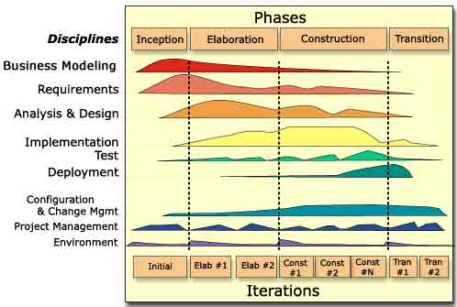
RATIONAL UNIFIED PROCESS

Slide 28
Systems Development - Summary
Software development requires traceability / decision justification.
SDLC (Waterfall Method) provides structure and traceability, but may critically extend lead times and is inflexible to change.
Software Prototyping uses iteration to encourage changes to be included throughout the design cycle, but requires close attention to ensure that a holistic solution is reached.
  SDLC + Software Prototyping commonly used to develop organisational information systems.
Understanding skills requirements for a given project is important and this needs to be realised in the early stages of the project.

